Slide 1

IL PAZIENTE POLITRAUMATIZZATO
Prof. Nicola Brienza
D.E.T.O. Sezione di Anestesia e Rianimazione
Università di Bari

Slide 2
Tri-modal distribution of trauma deaths
Immediate deaths: major severe injuries
Lacerations:
Brain, Brainstem
Large vessel, Heart
High spinal cord
80%
Best treated by prevention
Early deaths: treatable, but life threatening injuries
Epidural, subdural
Hemopneumothorax
Pelvic, Long bone fractures
Abdominal injuries
Brain injury
Shock
Late deaths
Treatable by ATLS principles
Directly related to earlier management
1 hour
3 hours
2 weeks
4 weeks
Time
Trunkey DD. Trauma. Sci Am, 1983
Notes:
Dal 1983…

Slide 3
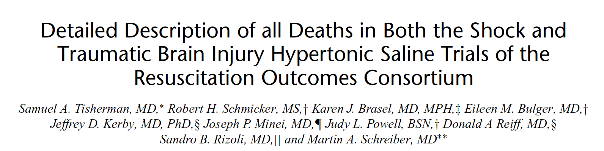

Most deaths from trauma with shock or TBI occur within 24 hours from hypovolemic shock or TBI.
Novel resuscitation strategies should focus on early deaths.
Significant improvements in trauma mortality will come from prevention initiatives and from interventions to prevent the early deaths from hemorrhage and TBI.
Notes:
Era giusta la visione del 1983 sulle cause principali di morte immediata. Quindi interesse su migliore trattamenta trauma cranico e shock emorragico

Slide 4
Most deaths from trauma with shock or TBI occur within 24 hours from hypovolemic shock or TBI.
Novel resuscitation strategies should focus on early deaths.
Significant improvements in trauma mortality will come from prevention initiatives and from interventions to prevent the early deaths from hemorrhage and TBI.
Notes:
Era giusta la visione del 1983 sulle cause principali di morte immediata. Quindi interesse su migliore trattamenta trauma cranico e shock emorragico

Slide 5
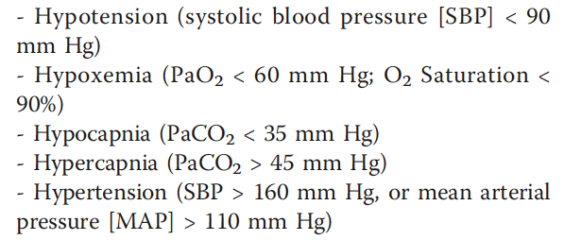
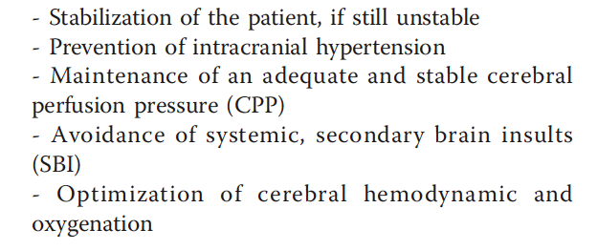
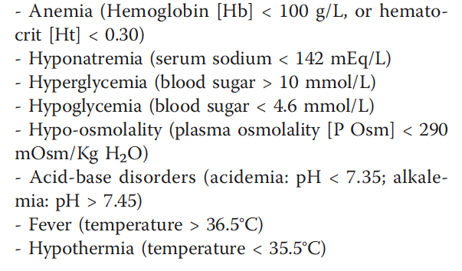
Critical care management of severe traumatic brain injury in adults
EVIDENCE-BASED STRATEGIES
Secondary brain insults
Haddad and Arabi. Scandinavian Journal of Trauma, Resuscitation and Emergency Medicine, 2012

Slide 6
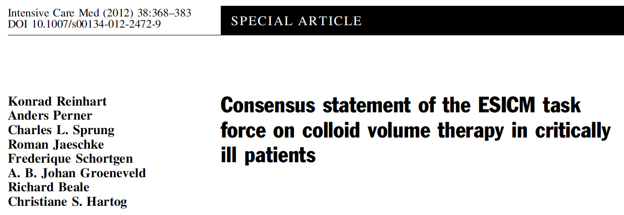
We recommend that solutions other than albumin be used in patients with head injury (grade 1C).
We recommend not to use synthetic colloid in patients with head injury or intracranial bleeding (grade 1C).
The subgroup of trauma patients with head injury from the SAFE trial who received 4% human albumin instead of 0.9% saline had a significantly higher risk of death

Slide 7
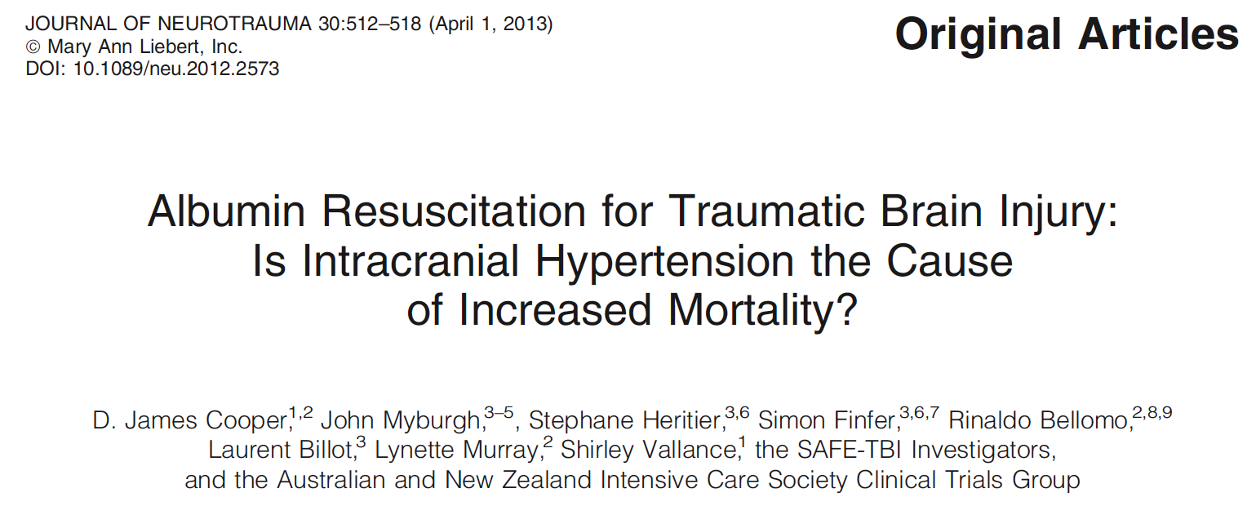
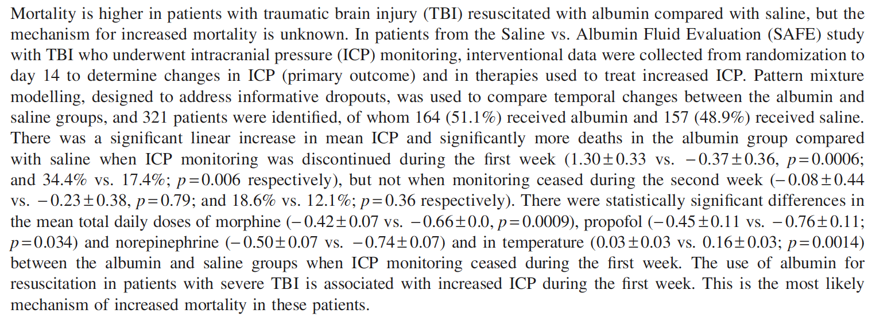
SEVERE TBI MANAGEMENT
Please, avoid Albumin resuscitation ……

Slide 8
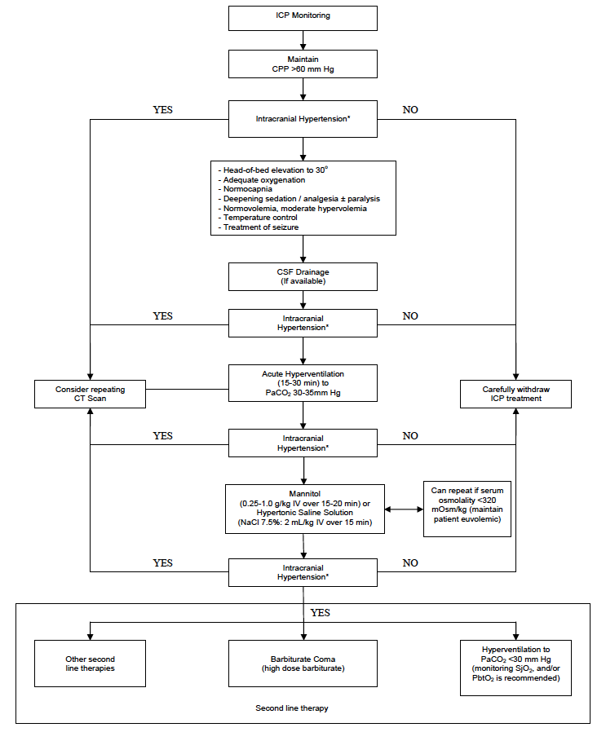
SEVERE TBI:
INTRACRANIAL HYPERTENSION
EVIDENCE-BASED STRATEGIES
Haddad and Arabi. Scandinavian Journal of Trauma, Resuscitation and Emergency Medicine, 2012
Notes:
Novità sulle terapie di seconda linea: craniectomia decompressiva.

Slide 9
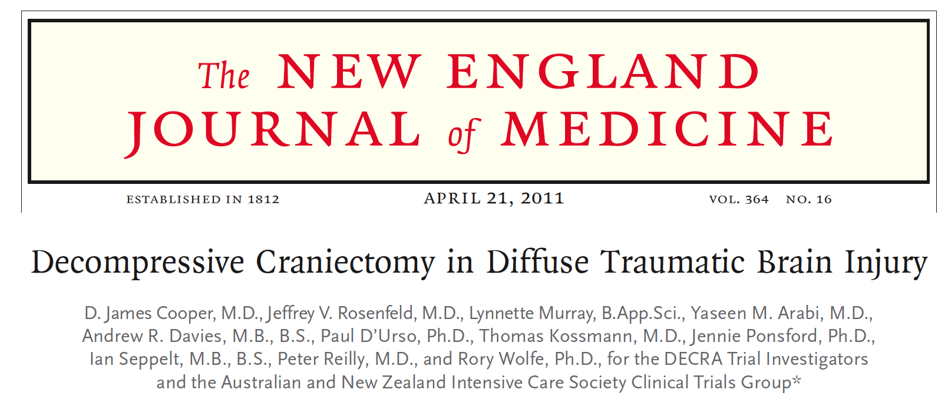
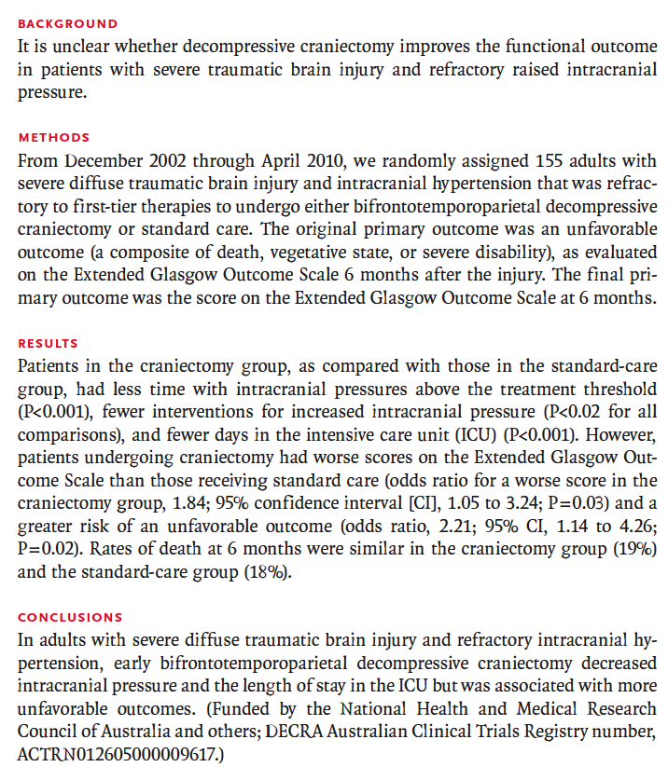
DECRA STUDY
Notes:
La craniectomia si associa ad outcome peggiore rispetto al trattamento standard

Slide 10
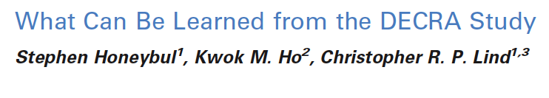
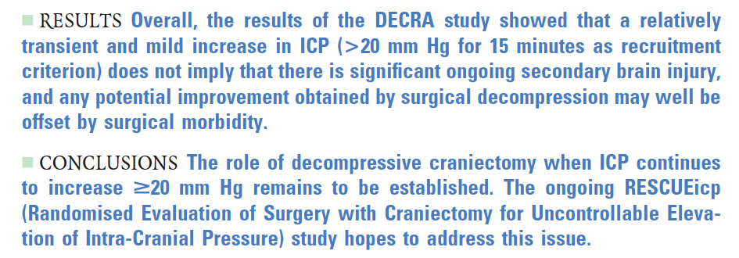
Notes:
Si scopre il bias : sono stati selezionati anche pazienti con ipeertensione transitorie e non particolarmente grave (20 per 15 min) per cui non poteva emergere un vero beneficio

Slide 11
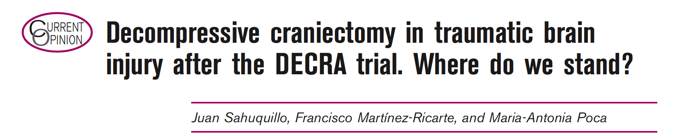
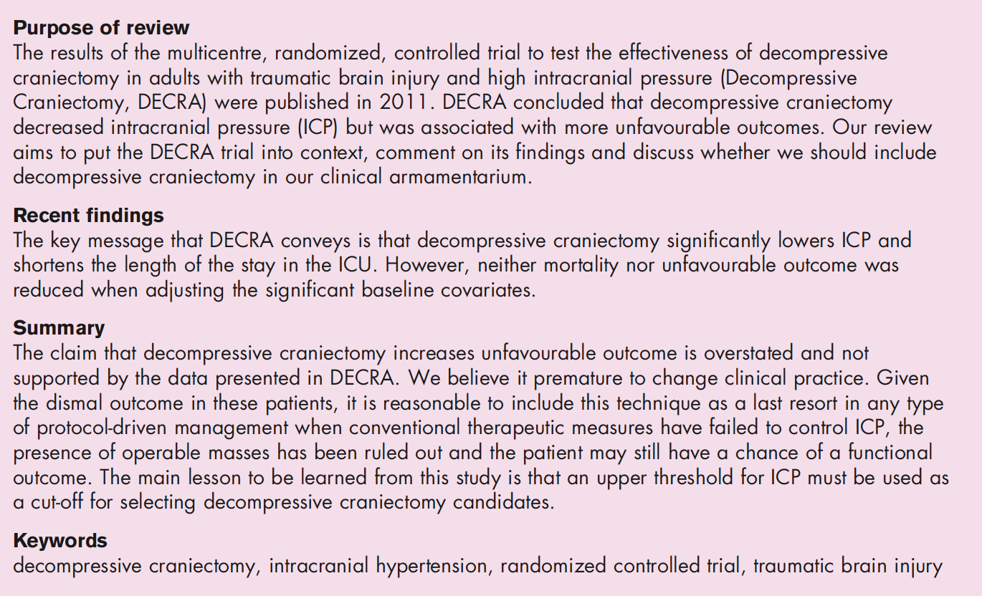

Slide 12
Most deaths from trauma with shock or TBI occur within 24 hours from hypovolemic shock or TBI.
Novel resuscitation strategies should focus on early deaths.
Significant improvements in trauma mortality will come from prevention initiatives and from interventions to prevent the early deaths from hemorrhage and TBI.
Notes:
Era giusta la visione del 1983 sulle cause principali di morte immediata. Quindi interesse su migliore trattamenta trauma cranico e shock emorragico

Slide 13
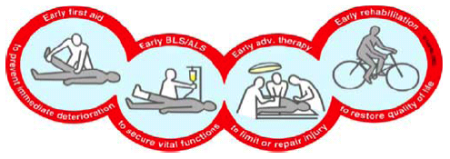
Emodinamica nel Trauma Maggiore…Alcuni concetti
Shock nel politrauma è prevalentemente emorragico … MA→ ≠ Shock emorragico da singola lesione ≠ Shock settico…
La cura del Trauma è un continuum…Fase PreH → Fase InH → PS/DE → Radiologia → Sala Op → ICU...
Ottimizzazione emodinamica “goal and phase oriented”

Slide 14
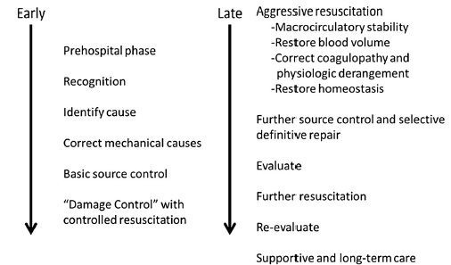
Fasi & Obiettivi
Fase preH
Fase precoce
(pre-controllo dell’Emorragia)
Fase tardiva
(post-controllo dell’Emorragia, post damage control)

Slide 15
Riconoscere lo Shock
Early Care : target 1
Combinazione di clinica, lesioni anatomiche, meccanismo del trauma & risposta iniziale al trattamemto (Grade 1C)
Macrocircolazione
  FC
  PA
Microcircolazione
  BE (< -3)
  Lattati (<2mmol/l)
Es. probabilità di TM TASH Score
Es. Score = 22 → 77% predicted need for massive transfusion.
http://www.mdcalc.com/tash-score-trauma

Slide 16
CLASSIFICAZIONE DELLO SHOCK IPOVOLEMICO
Classi
Volemia
Perdite(mL)
HR
Riemp.capillare
RR
PAS
Estremità
Sensorio
1
15%
750
tachi.modesta
normale
normale
normale
normali
normale
2
30%
800-1500
100-120*
>2 sec.
normale
normale
pallide
ansia
*polso
piccolo
3
40%
1500-2000
100-120*
>2sec.
tachipnea
bassa
pallide
sonnolenza
*polso
filiforme
4
>40%
>2000
>120*
n.v.
tachipnea
n.v.
fredde
coma
*polso radiale assente
(n.v. non valutabile)

Slide 17
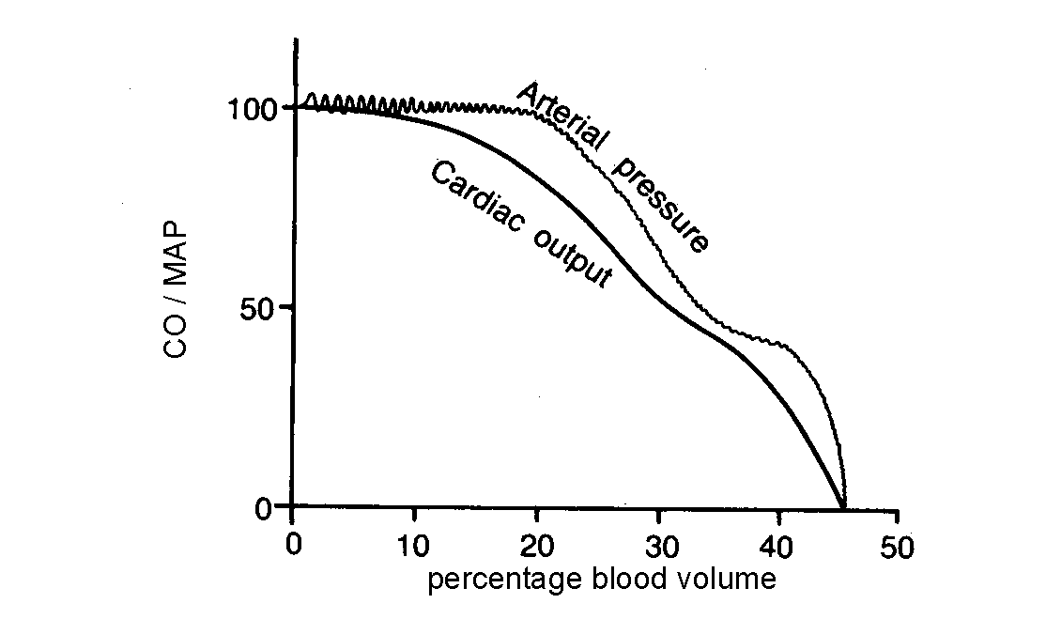

Slide 18
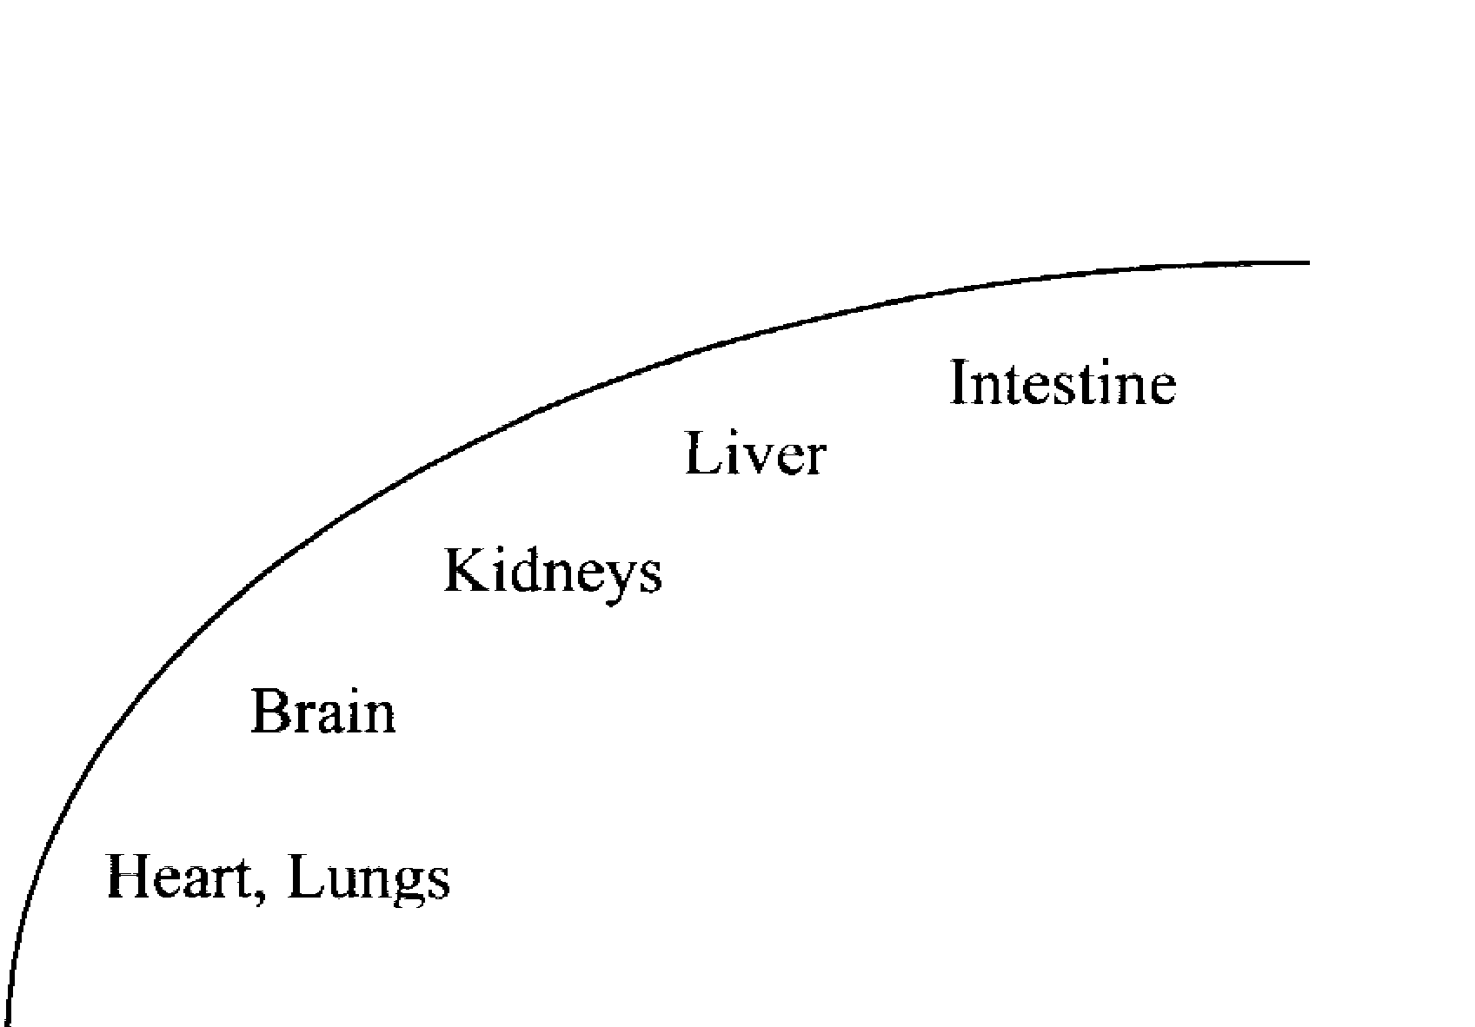
Gittata cardiaca
Perfusione
intestino
fegato
rene
SNC
Cuore, polmoni
Precarico
Modificata da Chang MC. New Horizons 1999;7:35-45

Slide 19
Il circolo splancnico è il più importante distretto vascolare del nostro organismo:
è un reservoir ematico - contenendo il 25-30% del volume sistemico (metà nel circolo intestinale)
riceve il 25% della gittata cardiaca
costituisce il “buffer emodinamico” delle variazioni dell’omeostasi cardiovascolare

Slide 20
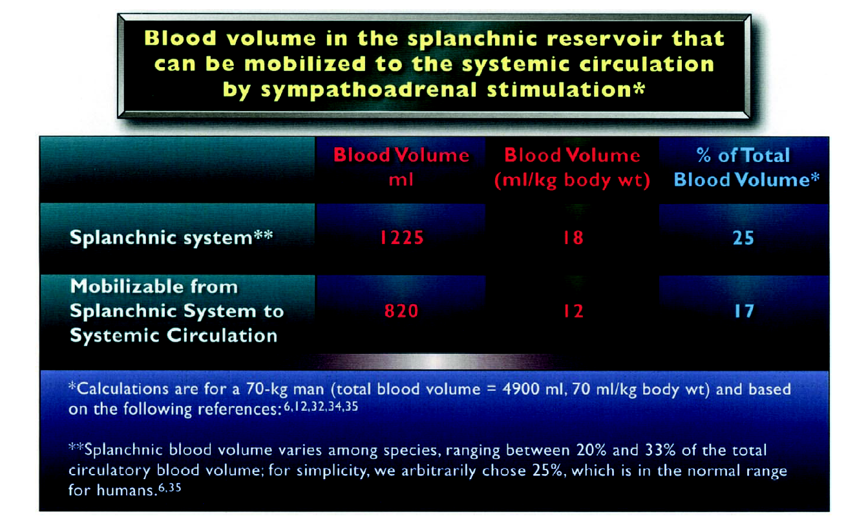

Slide 21
25-30%
gittata cardiaca
Aorta
A. gastrica
fegato
A. epatica
Tr. celiaco
Extra
splancnici
Vena porta
Aa. mesenteriche
organi splancnici 30% volume ematico

Slide 22
15-20%
gittata cardiaca
Aorta
A. gastrica
fegato
A. epatica
Tr. celiaco
Extra
splancnici
Vena porta
Quando la pressione arteriosa e la gittata cardiaca si riducono per ipovolemia, sia il flusso splancnico che il volume ematico diminuiscono

Slide 23
Gittata cardiaca
Perfusione
intestino
fegato
rene
SNC
Cuore, polmoni
Precarico
Modificata da Chang MC. New Horizons 1999;7:35-45

Slide 24
“Rene da Shock”
Il rene è un organo sensibile all’ipossia che risponde allo shock con l’immissione in circolo di Aldosterone e Renina, che, a loro volta, attivano l’Angiotensina, con aggravamento del danno ipoperfusivo attraverso una ulteriore vasocostrizione.
Negli stadi precoci si realizzano solo disturbi funzionali cui seguono, se lo shock persiste, danni organici con evoluzione verso l’insufficienza renale acuta (IRA)

Slide 25
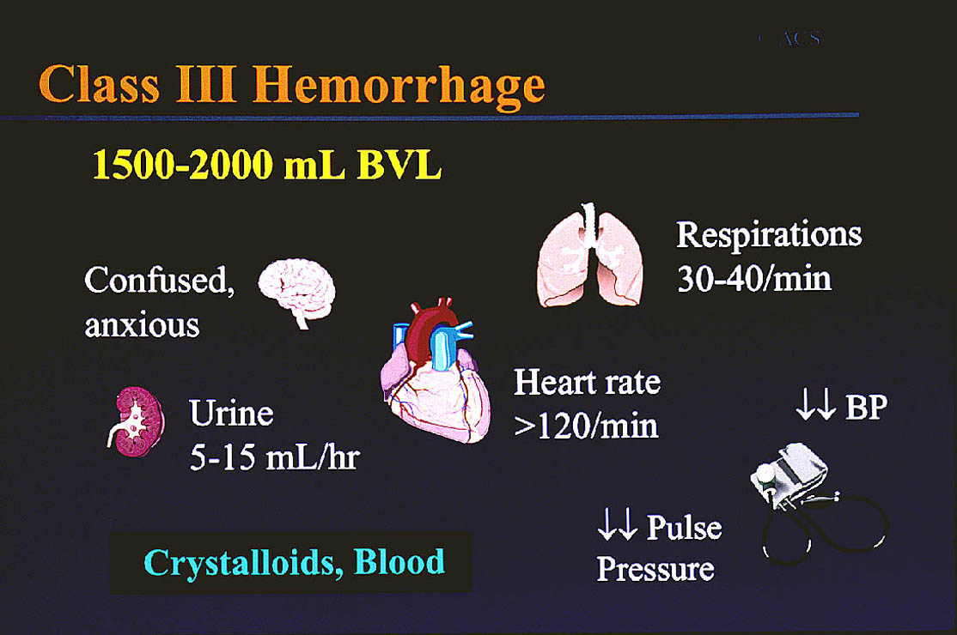

Slide 26
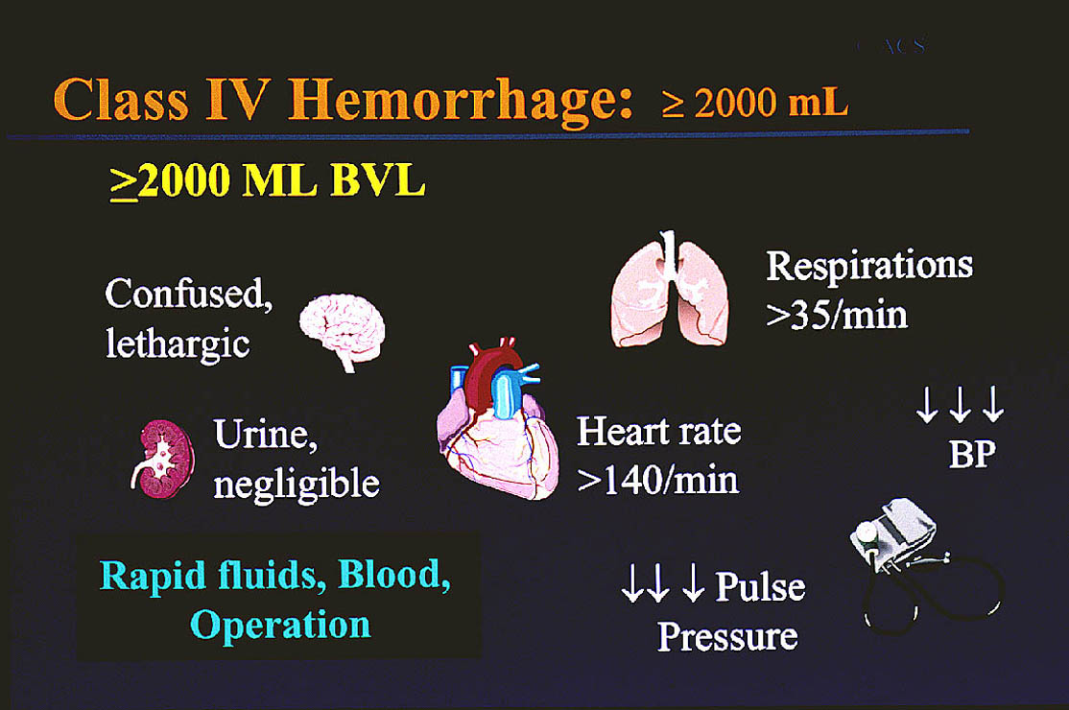

Slide 27
Gittata cardiaca
Perfusione
intestino
fegato
rene
SNC
Cuore, polmoni
Precarico
Modificata da Chang MC. New Horizons 1999;7:35-45

Slide 28
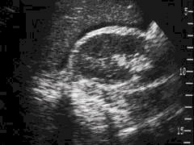
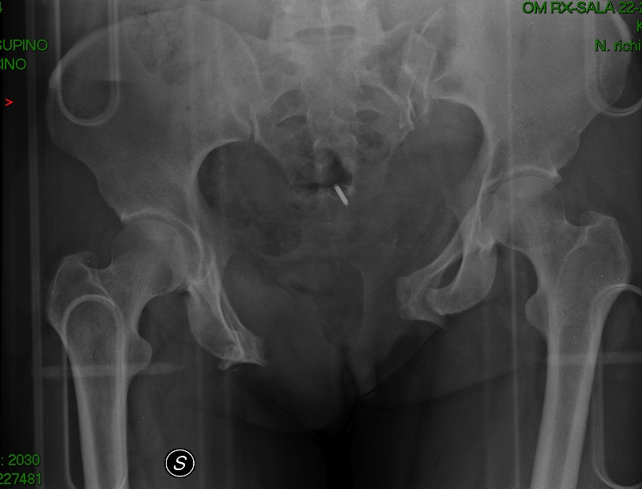
Individuare la sede del sanguinamento
Early Care : target 2
“One is the floor and 4 more”
E-FAST
Rx Torace /Bacino
TC
Emorragie esterne
Torace
Addome
Retroperitoneo
Arti

Slide 29
 | Pro | Con
ECO e-FAST + Rx Torace/Bacino | - Rapidità risposta per decision making (es. sala op se emoperitoneo + shock) - Non spostamento - Ripetibile | Informazioni incomplete (no aria, no retroperitoneo)
TC total body | > Dettaglio > Bilancio lesionale completo | > Tempo (time is bleeding) Spostamento paz instabile

Slide 30
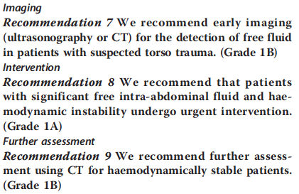
Quale imaging ?
Imaging&Time
E-FAST
Instabilità
emodinamica
TC

Slide 31
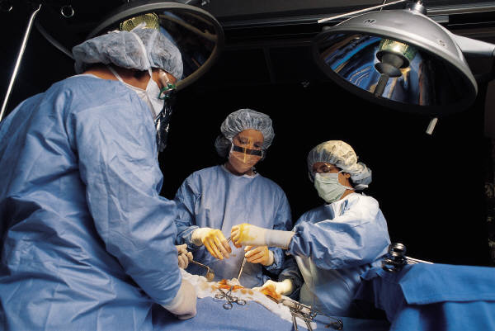
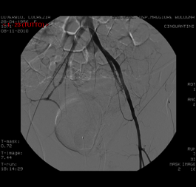
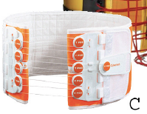
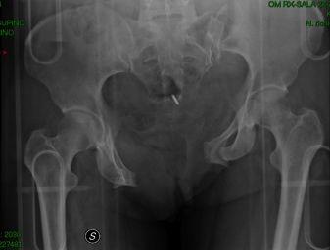
Stop the Bleeding!
Early Care : target 3
Compressione
diretta
ARRESTARE
l’emorragia!
Chirurgia
Ridurre
il volume pelvico
Immobilizzare
le fratture
Embolizzare
© ACS
Notes:
31
3-11 What can I do about it?
The instructors reveals the items on the slide after eliciting responses from the students. The instructor may ask a student to recall the most common cause of shock in the injured patient, emphasizing the need to identify and stop the hemorrhage by the most direct and simplest means available while avoiding blind clamping and applying a tourniquet. These might include direct pressure to control external hemorrhage, reducing pelvic volume, and splinting fractures.
Students’ responses to this question also should include controlling hemorrhage with operative intervention, eg, celiotomy and/or thoracotomy.
The “stop the bleeding!” sign spirals in from the top left with the first mouse click. Each graphic appears with a click of the mouse with the corresponding text in this sequence: (2) direct pressure, (3) operation, (4) reduce pelvic volume, and (5) splint fractures.

Slide 32
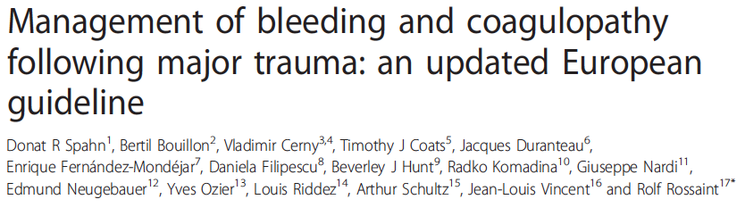

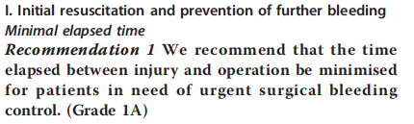
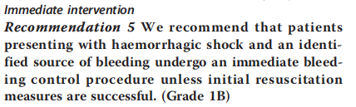
TEMPO
In S.Op. prima possibile

Slide 33
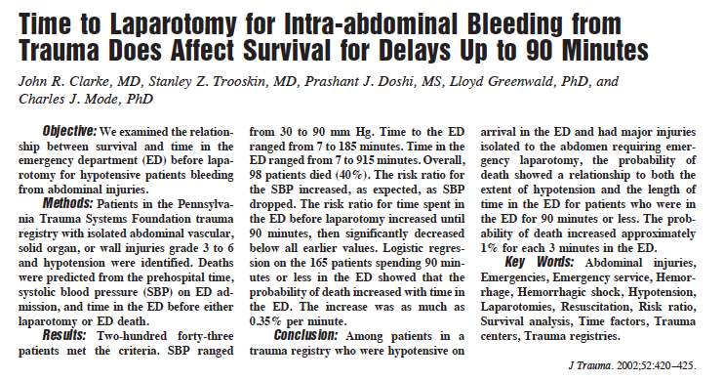
The probability of death increased 1% for each 3 minutes in the ED...

Slide 34
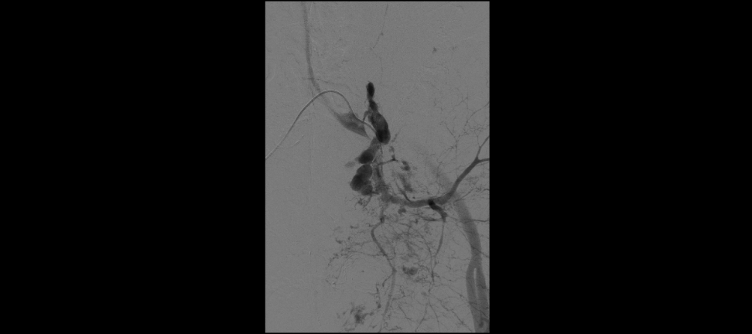
Damage control Intervention
Early Care : target 4
Damage control Surgery
Packing (epatico, Preperitoneale)
Angiografia /Embolizzazione
Goal: chirurgia entro 30’-60’
Goal angio: entro 90’

Slide 35
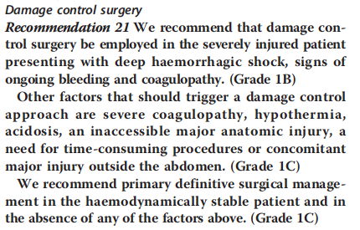
Emostasi & Shock: Damage Control Surgery

Slide 36
SHOCK MANAGEMENT IN TRAUMA: A PARADIGM SHIFT
DCR
In the last few years, there has been a paradigm shift in the management of the severely injured trauma patient.
As our understanding of the nature of trauma-related coagulopathy evolved, and with the recent combat trauma experiences in Iraq and Afghanistan, the concept of DCR in trauma was born.
The term “damage control” itself originated from World War II description of the US Navy’s strategy to salvage sinking ships.
The—then—new strategy avoided immediate definitive repair of the damaged vessel, and focused instead on preserving only what was needed to return the ship safely back into the port (e.g. watertight integrity, propelling power) for eventual definitive repair.

Slide 37
The term ‘damage control’ connotes the application of early and aggressive life-saving techniques, and describes the surgical practice of quickly controlling hemorrhage and containing contamination, with delayed definitive repair of injuries.
Likewise, damage control resuscitation describes the rapid correction of hypothermia and acidosis, as well as the direct treatment of coagulopathy.
In particular, it involves the early transfusion of trauma patients, the use of permissive hypotension, and minimization of crystalloid use.
Notes:
Priorità nella somministrazione di sangue ed emoderivati

Slide 38
THE HYPOTENSIVE BLEEDING TRAUMA PATIENT.
PRIMARY GOAL: STOP THE BLEEDING
YES
IDENTIFIED SOURCE
NO
IMMEDIATE BLEEDING CONTROL PROCEDURE
Grade 1 B
IMMEDIATE FURTHER INVESTIGATION
Grade 1 B
YES
HAEMODINAMICALLY UNSTABLE
NO
URGENT INTERVENTION IF FREE INTRA-ABDOMINAL FLUID
Grade 1 A
FURTHER ASSESSMENT BY USING CT
Grade 1 B
Early bleeding control of the abdomen must be achieved by using packing, direct surgical bleeding control and the use of local haemostatic procedures.
In the exsanguinating patient, aortic cross-clamping may be employed as an adjunct. (Grade 1C)
Patients with pelvic ring disruption in haemorrhagic shock must undergo immediate pelvic ring closure and stabilisation.(Grade 1B)
Patients with ongoing haemodynamic instability despite adequate pelvic ring stabilisation receive early preperitoneal packing, angiographic embolisation and/or surgical bleeding control. (Grade 1B)
Spahn et al. Crit Care 2013

Slide 39
SHOCK MANAGEMENT IN TRAUMA: A PARADIGM SHIFT
DAMAGE CONTROL RESUSCITATION STRATEGY
INJURY
Goal: get the patient to the trauma center
Scoop & run
Minimize fluid resuscitation
Prevent hypothermia
PRE-HOSPITAL CARE
(less than 20 mins)
Goal: mobilize promptly to OR/IR suite
Allow permissive hypotension
Administer blood & bloos products early
Minimize fluid resuscitation
Start tranexamic acid
Start massive transfusion protocol
EMERGENCY ROOM
Lamb CM, et al. British Journal of Anaesthesia 113 (2): 242–9 (2014)
ICU stay
(2-8 days)
Notes:
IR radiiologia interventistica

Slide 40
Damage Control Resuscitation: 1. Hypotensive
Early Care : target 5
Accettare livelli di PA più bassi (PAS 80-90)
Garantire PPcerebrale
Limitare uso cristalloidi/colloidi
Ridurre il “popping the clot”
Fino a ottenimento emostasi
Impiegando minor temo possibile

Slide 41
“Early Goal” Emodinamici
new
Obiettivi
PAS 80- 90 mmHg
→ Trauma Chiuso/Penetrante
… perfusione d’organo…
No “pop the clot” prima dell’emostasi
PAS 100-110 mmHg
→ Trauma Cranico
PAM >80-90 … perfusione cerebrale…

Slide 42
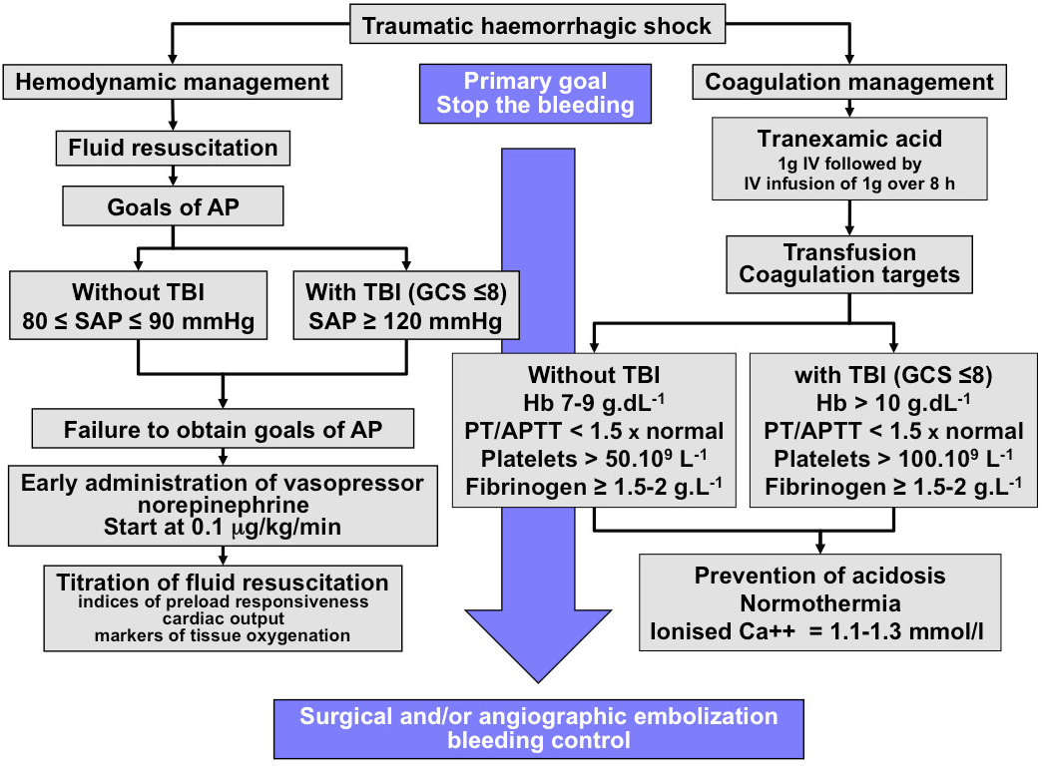
Spahn et al. Crit Care 2013

Slide 43
PRE-HOSPITAL PHASE
HOSPITAL PHASE
SURVIVAL
GROUP 4
0 %
MAP
FR to MAP 80 mmHg
GROUP 4
HEMOSTASIS
Blood to Hct 30%
GROUP 3
60 %
FC to MAP 80 mmHg
FR to MAP 40 mmHg
GROUP 3
GROUP 2
10%
NO FR
NO TREATMENT
GROUP 1
0%
GROUP 1, 2
GROUP 1
TAIL
CUT
0
15’
30’
90’
150’
(Capone, 1995)

Slide 44
Outcome of pts with penetrating injuries
according to treatment
Immediate resuscitation Delayed resuscitation
Survival 193/309 (62%) 203/289 (70%) **
Intraoperative loss 3000 ml 2500 ml
LOS (days) 14 (24) 11(19) **
(Bickell NEJM 1994)

Slide 45
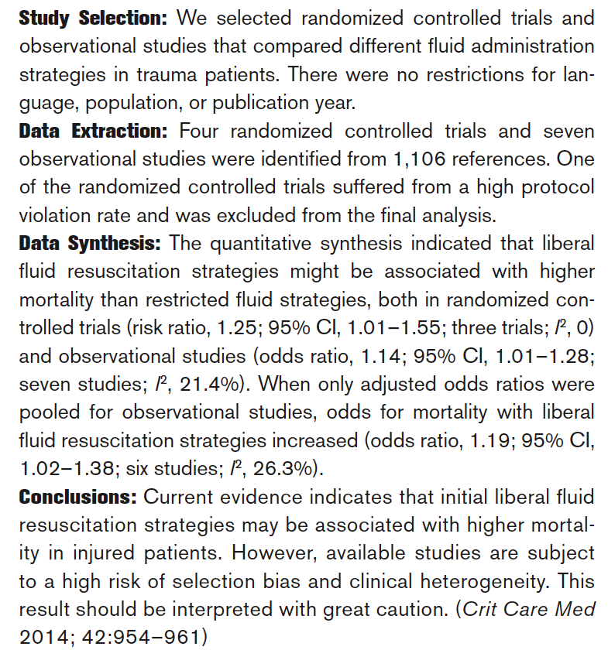
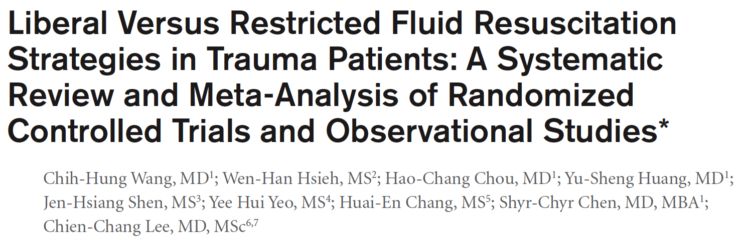
THE HYPOTENSIVE BLEEDING TRAUMA PATIENT: INTENSIVE CARE ISSUES

Slide 46
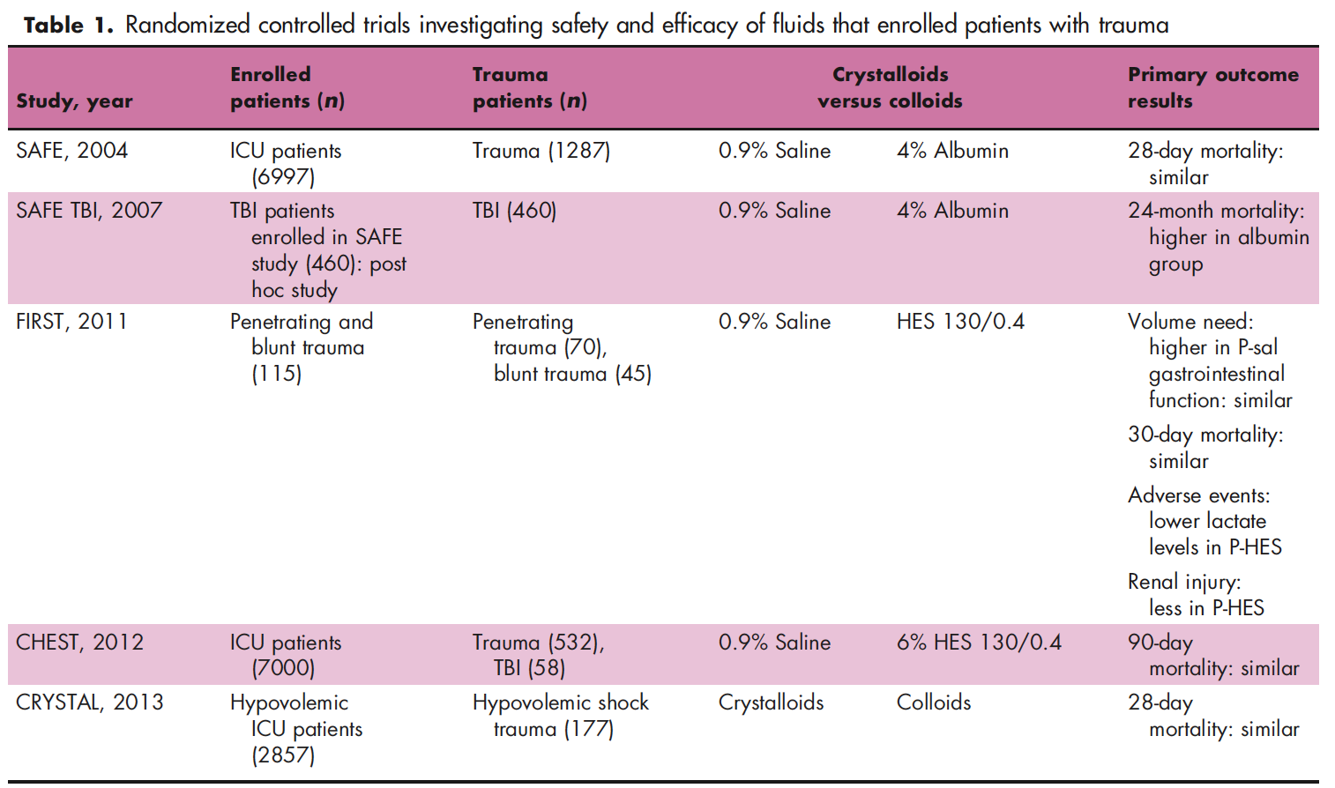
THE HYPOTENSIVE BLEEDING TRAUMA PATIENT: INTENSIVE CARE ISSUES
Which fluid?
Coppola S, et al. Curr Opin Crit Care, 2014

Slide 47
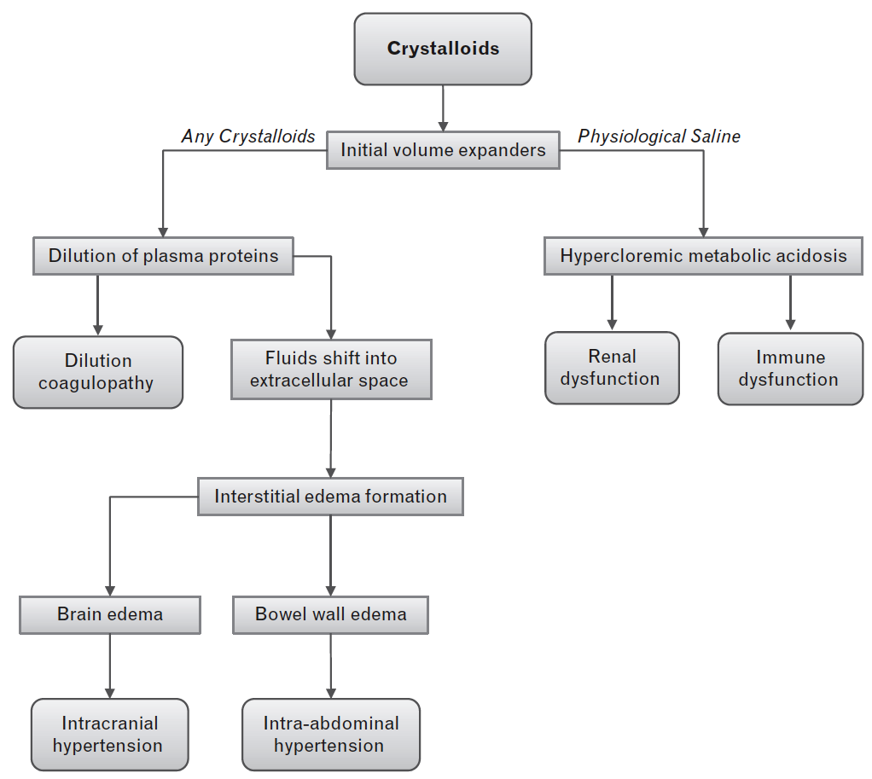
THE HYPOTENSIVE BLEEDING TRAUMA PATIENT: INTENSIVE CARE ISSUES
Which fluid?
Coppola S, et al. Curr Opin Crit Care, 2014

Slide 48
THE HYPOTENSIVE BLEEDING TRAUMA PATIENT: INTENSIVE CARE ISSUES
TISSUES PERFUSION AND OXYGENATION MAINTENANCE
FLUID THERAPY
Start with crystalloids (1B)
Colloids within the prescribed limits for each (2B)
Hypertonic solutions in unstable patients with torso trauma (2C)
Avoid hypotonic solutions in severe TBI (1B)
Target PAS 80-90 mmHg (1C) , ≥ 80 mmmHg (severe TBI) (1C)
Serum lactate and BE within normal ranges
VASOPRESSORS if no response to fluids (2C).
INOTROPES if myocardial dysfunction (2C).
RBC
Target Hb 7 - 9 g/dl. (1C)
BLEEDING AND SHOCK MONITORING
Serial Hb, Hct, and serum lactate or BE (Grade 1 B)
Spahn et al. Crit Care 2013

Slide 49
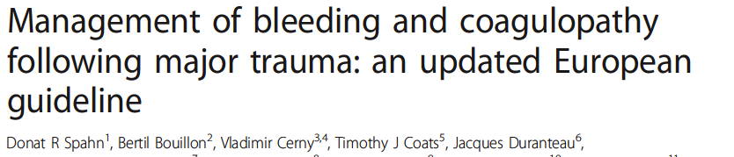
Vasopressors and inotropic agents
Recommendation 15
We suggest administration of
vasopressors to maintain target arterial pressure in
the absence of a response to fluid therapy. (Grade 2C)
We suggest infusion of an inotropic agent in the
presence of myocardial dysfunction. (Grade 2C)

Slide 50
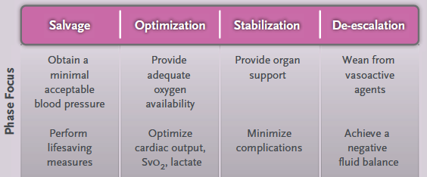
Fasi del trattamento dello shock
Early Care
Late /Definitive

Slide 51
Fase 2: Ottimizzazione
Goal | Azioni | Monitoraggio
Incrementare DO2 Full Resuscitation | Ottimizzazione emodinamica Controllo coagulopatia | Microcircolazione (SvcO2, lattati, BE, P(v-a)CO2 Macrocircolazione (CO, SVR, SSV, PPV) Ecodinamico Coagulazione metodi viscoelastici

Slide 52
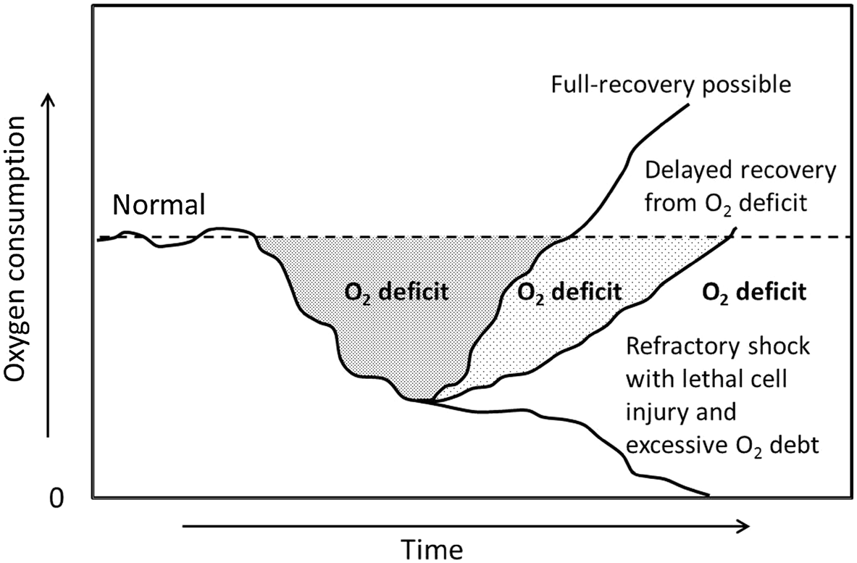
Tempo = fattore chiave nella resuscitation…
Shere-Wolfe et al. Scandinavian Journal of Trauma, Resuscitation
and Emergency Medicine 2012, 20:68

Slide 53
Damage Control Resuscitation: 2. Haemostatic
Early Care : target 6
Attivazione precoce Protocollo Trasfusione massiva
Fixed Ratio: Emazie – Plasma- piastrine
Ac. Tranexamico
Fibrinogeno
Terapia con emocomponenti POC guidata
Trattare e prevenire al Coagulopatia indotta da Trauma (TIC)

Slide 54
Spahn et al. Crit Care 2013

Slide 55
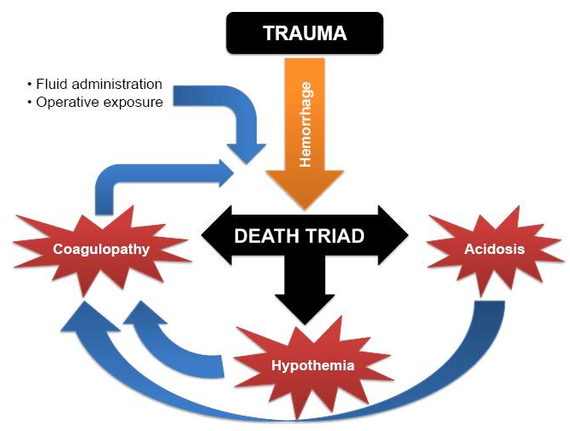
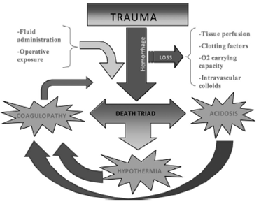
SHOCK MANAGEMENT IN TRAUMA: A PARADIGM SHIFT
Most preventable trauma deaths are due to uncontrolled hemorrhage.
The coagulopathy of trauma is a multifactorial and early phenomenon, often present even prior to the dilutional effects of resuscitation.
Notes:
Nopn solo effettop di emodiluizione ma caratterstica del politrauma che insorge precocemente ed è alimentata dalla triade del trauma.

Slide 56
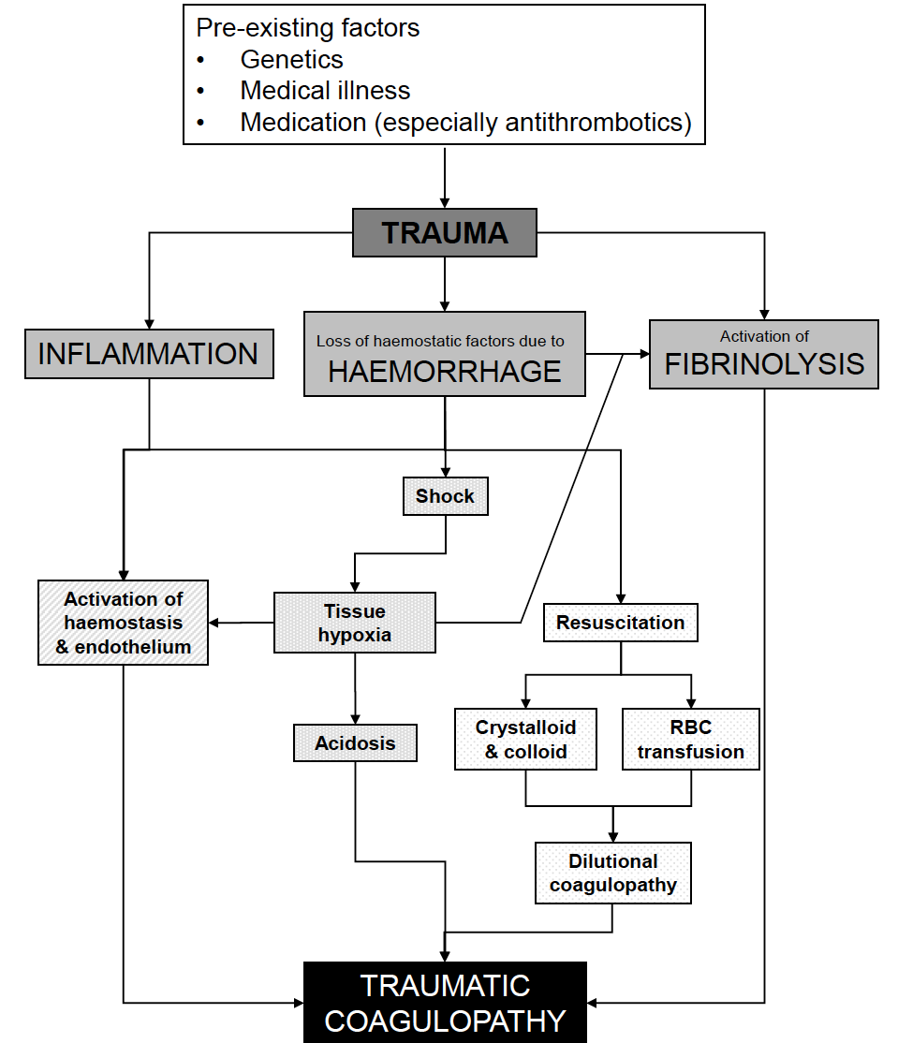
ACUTE TRAUMATIC COAGULOPATHY
There is evidence to suggest that 25% of severely injured patients are coagulopathic at the time of admission, independent of haemodilution or factor depletion.
This condition has been referred to as acute traumatic coagulopathy (ATC) and appears to be related to direct tissue trauma, hypoperfusion and inflammation, resulting in hyperfibrinolysis and endothelial activation. This coagulopathy is further compounded by the associated hypothermia and acidosis of the so-called ‘lethal triad.
Presentation with ATC has been shown to significantly increase mortality and, thus understanding the mechanism to guide intervention is an active area of research.
Spahn et al. Crit Care 2013

Slide 57
Transfusion Target
Early Care : target
Senza TBI
Con TBI
Hb 7-9
Pt/PTT <1,5 normal
PLT > 50x10⁹
Fibrinogeno > 1.5-2 g/L
Hb > 10
Pt/PTT <1,5 normal
PLT > 100x10⁹
Fibrinogeno > 1.5-2 g/L

Slide 58
Transfusion Target quali strategie…?
Early Care : target
Fixed (empiric) ratio
  → Emazie:Plasma:PLT → <2:1:1
  Massive Transfusion Protocol
Goal directed component Tx:
  POC guided
  Terapia con componenti: Fibrinogeno, PLT, PPC…

Slide 59
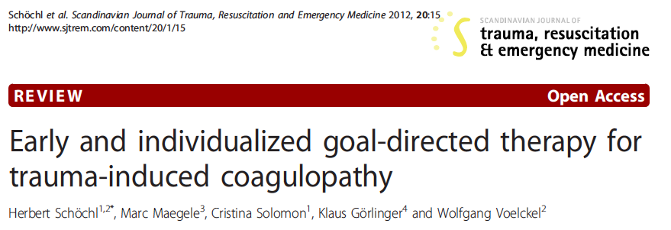
Test standard della coagulazione: time consuming, riportati a 37° , non riflettono coagulazione in vivo
Early & Individualizzata Vs “fixed ratio emazie-plasma
Riduzione rischio di “under transusion”: emorragia
“over-transfusion” : ARDS, ALI, sepsi, MOF

Slide 60
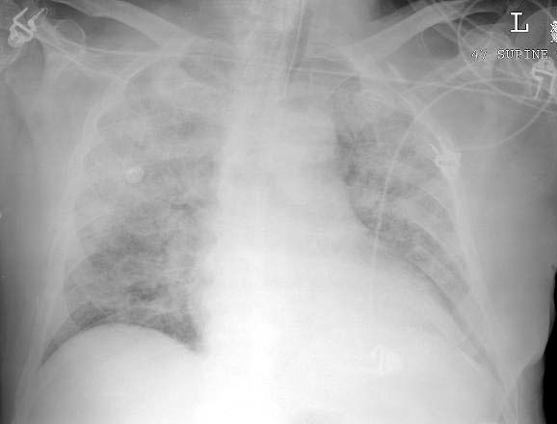
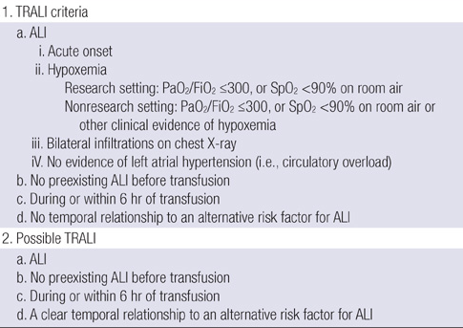
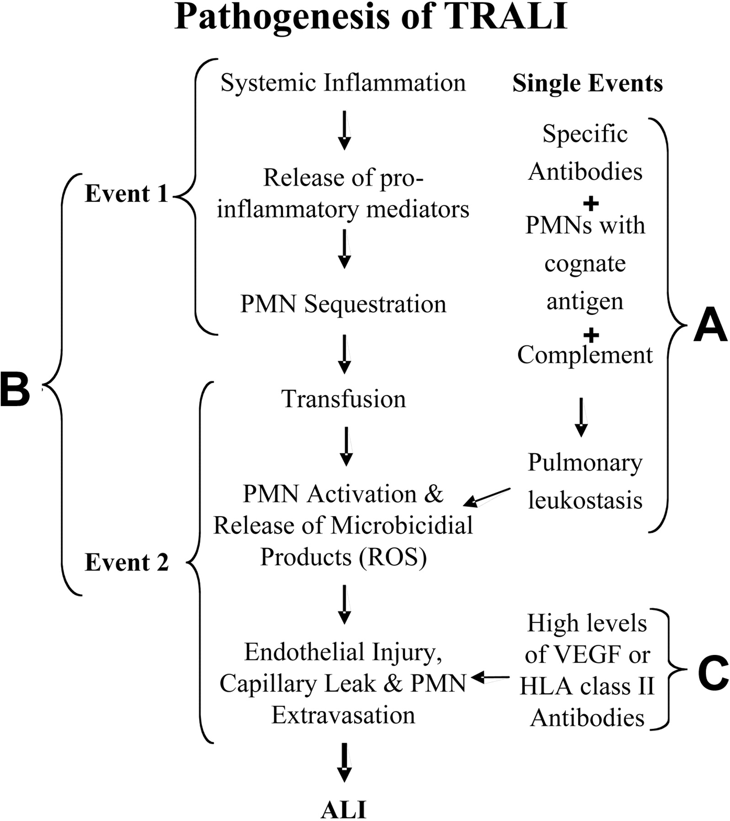
Transfusion related Acute Lung Injury

Slide 61
Transfusion associated circulatory overload
There is no universally agreed-upon definition for what constitutes TACO.
During or within several hours of transfusion, patients develop respiratory distress, and may develop orthopnea, cyanosis, tachycardia, and hypertension.
Rales can be identified on auscultation, and some patients may have jugular venous distention, an S3 on cardiac auscultation, or lower extremity edema.
A chest radiograph can reveal cardiomegaly and interstitial infiltrates, but not all patients with heart failure will have these abnormalities
Robert C. Skeatea and Ted Eastlund. Current Opinion in Hematology 2007

Slide 62
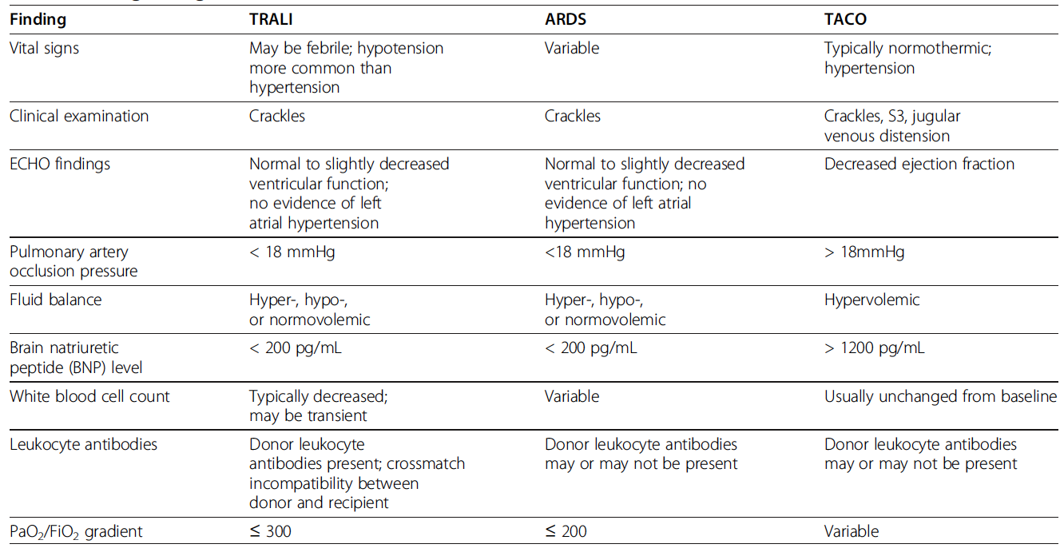
Distinguishing TRALI from TACO and ARDS
Shere-Wolfe et al. Scandinavian Journal of Trauma, Resuscitation and Emergency Medicine 2012

Slide 63


Obiettivi emodinamici variano a seconda della fase di trattamento del trauma
Approccio ABCDE
Prima fase:
Stop the Bleeding!
Damage Control Resuscitation &
Damage Control Surgery
Seconda Fase: riequilibrio dell’omeostasi, full resuscitation

Slide 64



Slide 65
Tri-modal distribution of trauma deaths
Immediate deaths: major severe injuries
Lacerations:
Brain, Brainstem
Large vessel, Heart
High spinal cord
Best treated by prevention
Early deaths: treatable, but life threatening injuries
Epidural, subdural
Hemopneumothorax
Pelvic, Long bone fractures
Abdominal injuries
Brain injury
Shock
Late deaths
Sepsis
MOF
Treatable by ATLS principles
Directly related to earlier management
1 hour
3 hours
2 weeks
4 weeks
Time

Slide 66



SEVERELY INJURED PATIENTS: OUTCOMES
Sepsis was the only independent promoter of MOF, ventilator-free days, critical care LOS, and hospital LOS
Cole E, et al. J Trauma Acute Care Surg, 2014
MORTALITY
Data from the 2005 and 2006 Nationwide Inpatient Sample developed by the Healthcare Cost and Utilization Project (n =1 55 891).
Controlling for patient demographics, mechanism of injury, injury severity, and comorbidities.
INPATIENT COSTS
Controlling for patient demographics, mechanism of injury, injury, comorbidities, and hospital factors (teaching status, rurality, geographic region)
Glance LG, et al. Arch Surg, 2011

Slide 67
IMMUNOLOGICAL RESPONSES TO SEVERE TRAUMATIC INJURY
Innate Immunity
Chronic low grade inflammation
TRAUMA
Fulminant death
Early MOF
CCI
Pro-Inflammation
PERSISTENT INFLAMMATION
PICS
persistent immunological catabolic syndrome
SIRS
Return to homeostasis
Rapid recovery
CARS
Protein catabolism/cachexia
Anti-Inflammation
Indolent death
Adaptative immunity
PROGRESSIVE IMMUNOSUPPRESSION
uncomplicated
Complicated outcomes
MASSIVE TRANSFUSION
NOSOCOMIAL INFECTIONS
Gentile LF, et al. J Trauma Acute Care Surg, 2012; Leentjens J, et al. Am J Respir Crit Care Med, 2013;
Angus DC, et al. N Engl J Med 2013; Vanzant EL, et al. J Trauma Acute Care Surg, 2014
Notes:
PICS : persisten immunological catabolic syndrome

Slide 68

The burden of infection in severely injured trauma patients
N=304; ISS 29 (25-49); infections 52%
Who is at risk ?
SHOCK ON ADMISSION
Multivariate analysis adjusting for the effects of age, ISS, GCS score, systolic blood pressure, lactate, BD, as well as PRBC and FFP use showed that only admission BD (OR 1.78) and lactate (OR 1.36) were independently associated with the development of infection.
Time to first infection was also related to the severity of shock.
Median time to first infection was earlier for all degrees of shock compared with those patients not shocked on admission.
Cole E, et al. J Trauma Acute Care Surg, 2014
Notes:
Ma il fattore più significativo fra i fattori che condizionano la mortalità è lo shock al ricovero

Slide 69
The Golden Hour
"There is a golden hour between life and death. If you are critically injured you have less than 60 minutes to survive. You might not die right then; it may be three days or two weeks later -- but something has happened in your body that is irreparable."
- R. Adams Cowley

Slide 70
THE “TWO-HIT PHENOMENON” IN MOF
REMOTE ORGAN INJURY:
liver, lung,….
FIRST HIT:
shock + reperfusion
MOF
SECOND HIT:
loss of the
gut mucosal barrier
with bacterial or
endotoxin translocation
Gut mucosal dysoxia
and reactive oxygen metabolites
CKs
eicosanoids
coagulation
complement
oxygen radicals
Mucosal
inflammatory
response
Macrophage
endothelial cell
neuthrophil

Slide 71

The burden of infection in severely injured patients
EARLY COAGULOPATHY
N=158; ISS 14 (9-29); infections 45%
Who is at risk?
ANTICOAGULANT PATHWAY
There is a strong association between the status of the coagulation system after 24 hours and the development of infection following trauma.
Improved early coagulation management may decrease infection rates in this patient group
FIBRINOLYTIC PATHWAY
Cole E, et al. J Trauma Acute Care Surg, 2013
Notes:
Più procoagulazione e più fibrinolisi= più infezioni

Slide 72


The burden of infection in severely injured patients
SOURCE OF INFECTION
N=304; ISS 29 (25-49); infections 52%
TIMING OF INFECTION
Cole E, et al. J Trauma Acute Care Surg, 2014

Slide 73

POST-TRAUMATIC PNEUMONIA
RISK FACTORS
Age
Depressed level of consciousness and impaired airways reflexes
Severity of injury: head, spinal, extremity injuries
Urgent field airways acquisition
Inalation injury in burns
Chest trauma, tube thoracostomy
BLUNT CHEST TRAUMA
A combined odds ratio of 5.24 (3.51–7.82, 95% CI) for mortality in blunt chest wall trauma patients who develop pneumonia.
Battle CE, et al. Injury, Int. J. Care Injured 43 (2012) 8–17

Slide 74
Tri-modal distribution of trauma deaths
Immediate deaths: major severe injuries
Lacerations:
Brain, Brainstem
Large vessel, Heart
High spinal cord
Best treated by prevention
Early deaths: treatable, but life threatening injuries
Epidural, subdural
Hemopneumothorax
Pelvic, Long bone fractures
Abdominal injuries
Brain injury
Shock
Late deaths
Sepsis
MOF
Treatable by ATLS principles
Directly related to earlier management
1 hour
3 hours
2 weeks
4 weeks
Time

